Slide 1
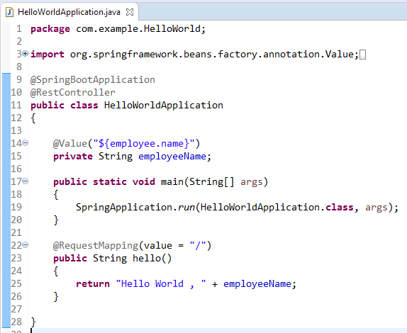

@Value Annotation
The @Value annotation is used to read the environment or application property value in Java code.

